Slide 1
Software Dispensing Machine
Detail: Date 29 April 2025 Description: Draft GUI and work flow of Software
Author : Atthaphan Paksakunnee 524161

Slide 2
HW Scheme
Barcode Reader
PC + Monitor
FITs
USB
API
I/O
list I/O output
Home
Start
Stop
Opti PASS
Opti FAIL
I/O Box
Nordson
Dispense Robots
OptiSure

Slide 3
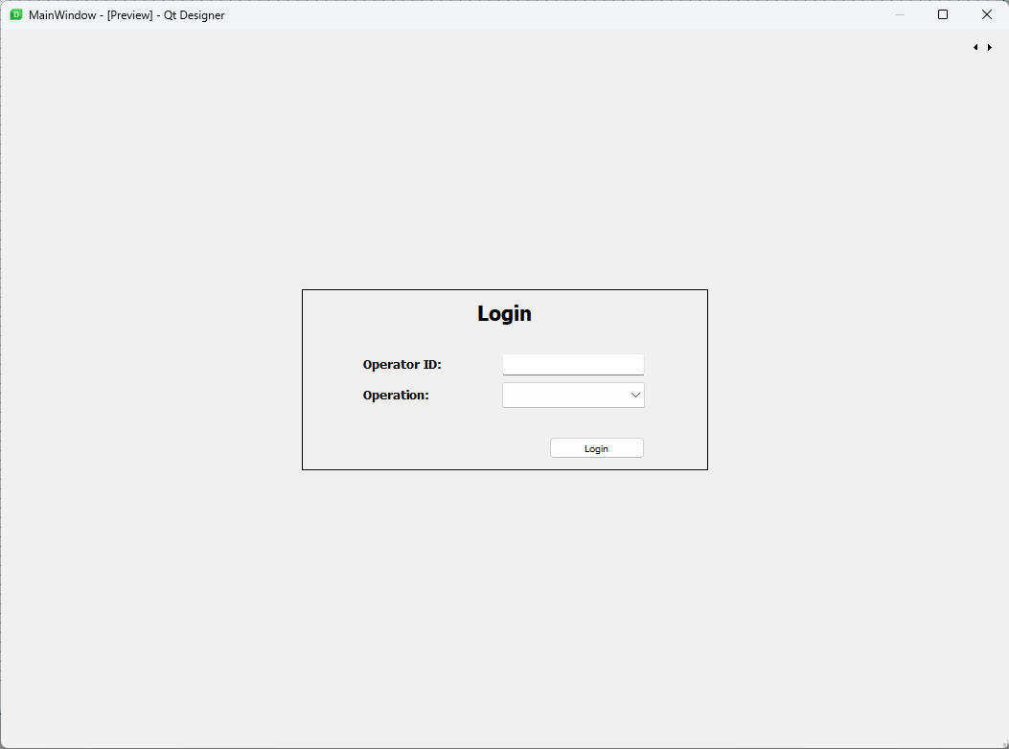
GUI Software
Login Window

Slide 4
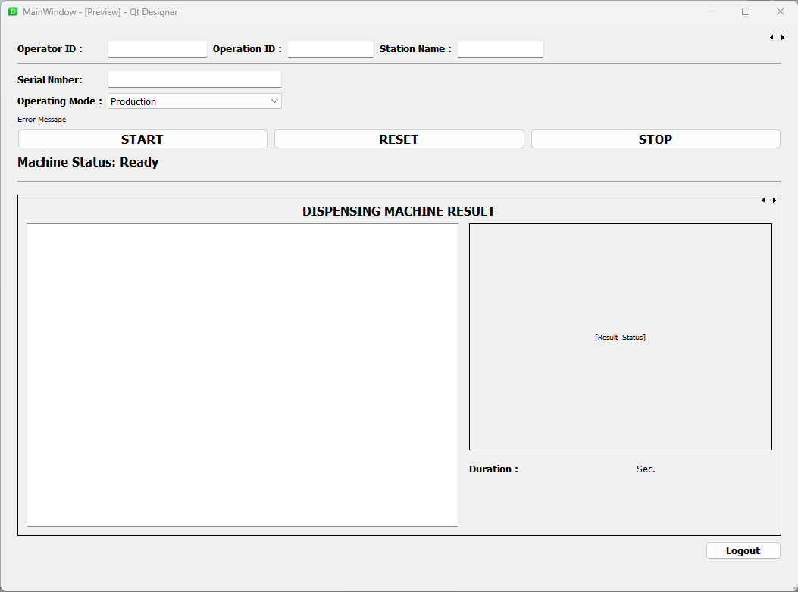
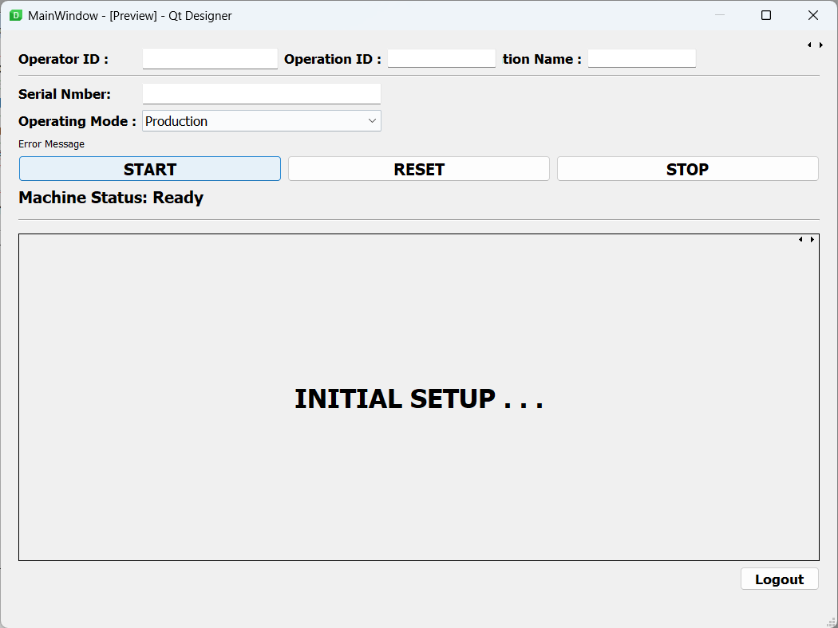
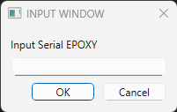
GUI Software
Main Window

Slide 5
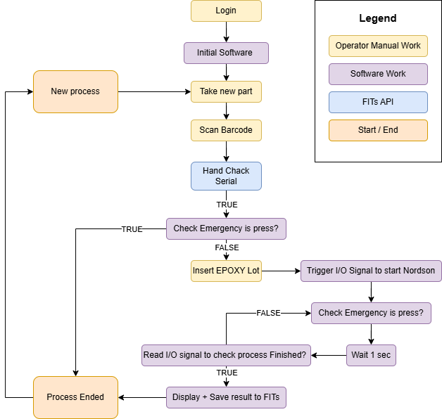
Workflow Scheme

Slide 6
Data Logging
Result data stored in correct format .csv file in local storage
Station ID
Operator ID
Timestamp
Barcode
program number
Result
Error code

Slide 7
Update
7 May 2025

Slide 8
Nordson I/O Pin Function
Input Configuration
Input | Description
Input | Default setting.
Start | A signal to start the execution of the dispense program.
Door | A signal to stop the execution of the dispense program. This configuration is to be used in tandem with the DOOR OPEN output configuration.
Stop | A signal to stop the execution of the dispense program.
Home | A signal to home/reinitialize the robot after a stop of the dispense program.
Table Ready | A signal to indicate that the system is ready to execute the dispense program. The dispense program will not execute if the input signal is off. This configuration is to be used in tandem with the TABLE READY output configuration.
Pause | A signal to pause the execution of the dispense program.
Call Program | A signal to initiate a specified program.
Z Detect | A signal to initiate Needle Z Detect.
XY Adjust | A signal to initiate Needle XY Adjust.
Purge | A signal to initiate a purge. For all enclosed systems, input 8 (In 8) must be set to Purge.

Slide 9
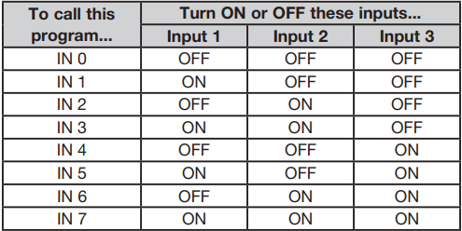
Nordson I/O Pin Function
Call Program from I/O
The Call Program functionality is binary. As shown in the table below, the program stored as IN 0 is called if all inputs are low (OFF). The program stored as IN 3 is called when inputs 1 and 2 are high (ON) and input 3 is low (OFF). Binary values 1, 2, 4, 8, 16, 32..., etc., equal inputs 1, 2, 3, 4, 5, 6..., etc.

Slide 10
Nordson I/O Pin Function
Output Configuration
Output | Description
Emergency | A signal indicating that the robot has stopped.
EMG-B | A signal indicating that the Emergency Stop button on the robot is pressed.
Running | A signal indicating that the dispense program is currently executing.
Homing | A signal indicating that the robot is reinitializing/moving to home position.
Standby | A signal indicating that the robot is in a standby (idle) position.
Pause | A signal indicating that the dispense program is paused.
System Start | A signal indicating that the Dispense Motion software is open and running.
Table Ready | A signal indicating that the system is ready to execute the dispense program. This configuration is to be used in tandem with the TABLE READY input configuration.
Door Open | A signal indicating that the door is open. This configuration is to be used in tandem with the DOOR input setting
No Start Trigger | A signal indicating that the program cannot run until the TABLE READY input signal is ON. When the TABLE READY input is ON, the NO START TRIGGER indication switches OFF. This configuration must be used with the TABLE READY input and the TABLE READY output configurations.

Slide 11
Nordson I/O Pin Function
Output Configuration (continued)
Output | Description
Teach Mode | A signal indicating that the robot is in the Teach mode. This signal can be used when the external start / stop box is present
Calibration Execution | A signal indicating that the robot is performing a Needle Z Detect or a Needle XY Adjust.
Positional Error | A signal indicating an over-limit warning after a general over-limit warning from program execution occurs.
In Home | A signal indicating that the tip is in the Park Position.
Barcode Scan | A signal indicating that a barcode has been scanned by the barcode reader.
AOI Fail | Applies only to systems using the OptiSure AOI technology. Refer to the OptiSure Automated Optical Inspection Operating Manual.
AOI Pass | Applies only to systems using the OptiSure AOI technology. Refer to the OptiSure Automated Optical Inspection Operating Manual.
MultiNeedle 1, 2, 3, 4, 5, or 6 | A signal indicating that a dispense has occurred from the specified needle (1 to 6).

Slide 12
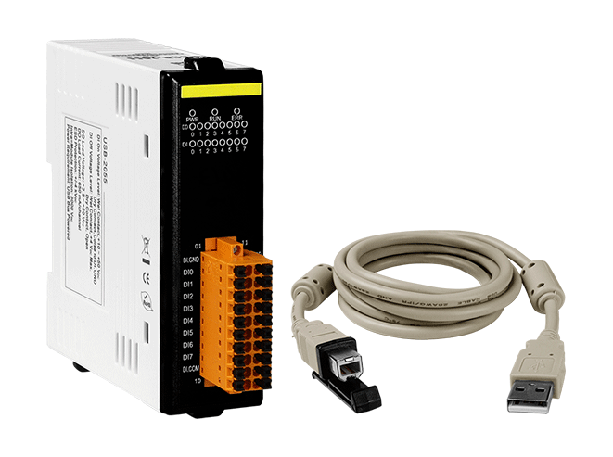
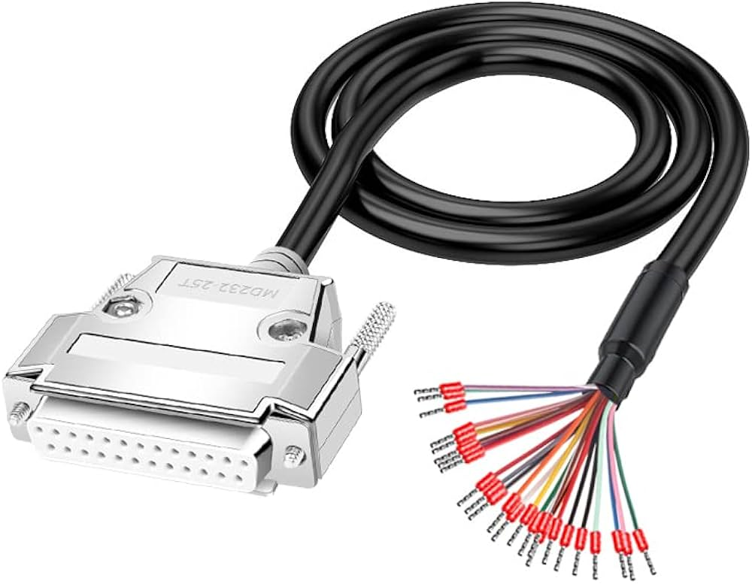
Communication Equipment
Method 1
DB25 Breakout open wire
USB I/O Modules (24VDC)

Slide 13
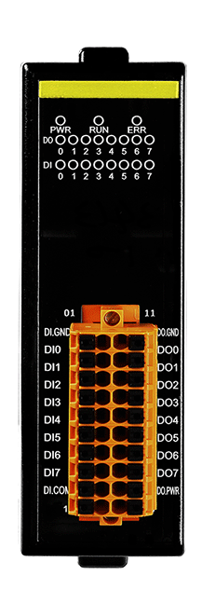
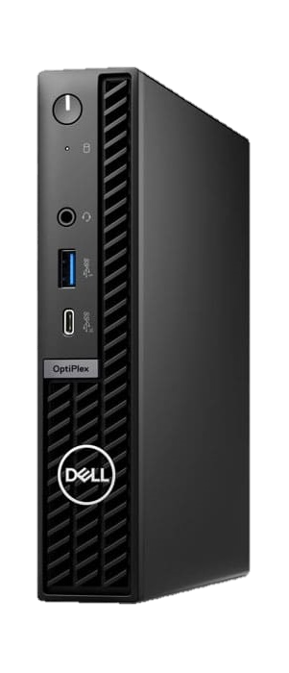
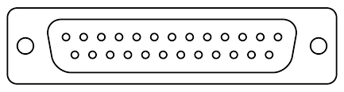
Wiring Diagram
I/O PIN
USB-B

Slide 14

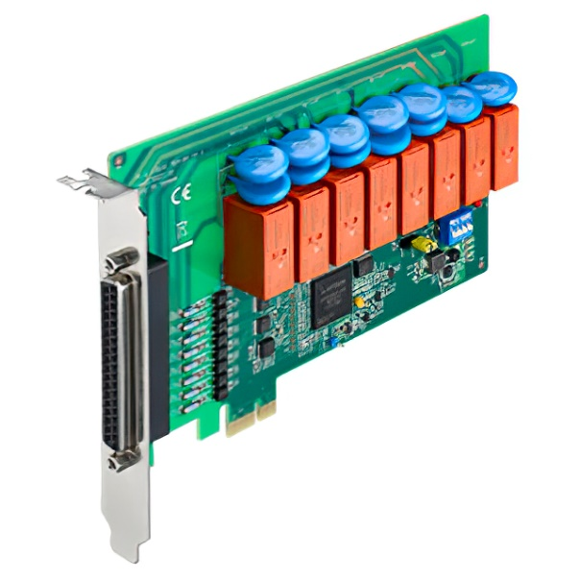
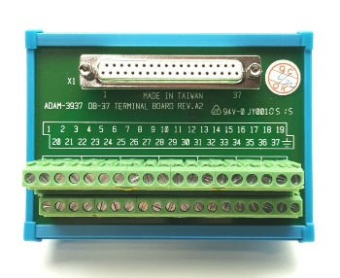
Communication Equipment
Method 2
DB25 Breakout open wire
PCIe I/O Card (24VDC)
DB37 Breakout board

Slide 15
I/O from I/O Box
#IN | OUTPUT
5 | Call Program
6 | Call Program
7 | Call Program
8 | Start
#OUT | INPUT
1 | Standby
2 | Running
3 | AOI Fail
4 | AOI Pass

